Slide 1

SOEN 6011
Software Engineering Process
Summer 2016
Team – Group 8
Presented By:
Amandeep Narula - 27359950
Dhruv Ohri - 27149220
Heya Na - 27208243
Mona Movahedi - 26979327
Parth Patel - 40014231
Prashanth Ramesh - 27382006
Sukhjit Singh - 40009670
Supreetha Mudarajappa - 27682417
Presented to
Prof - Nicolangelo Piccirilli
TA-Dittimi Tamarafinide

Slide 2
INTRODUCTION
It’s a traditional game which was also known as Noughts and Crosses.
1st played in roman empire in early century BC.
Includes 3X3 grid consisting of two players X and O,
who take turns marking the spaces .
The player who succeeds in placing three of their marks in a horizontal, vertical, or diagonal row wins the game.
The same game has been taken as reference and we have
tired to implement as an Android app, as
well as a Desktop application.

Slide 3
FEATURES
Deliverable 1
3 X 3 Board displayed on the screen
Choose X or O for display on the Game board
Draw “X” and “O”
Exit the game

Slide 4
FEATURES (continued)
Deliverable 2
Help Button
Start a new game
Display status of whose turn it is
Display best of 5 game series
How many games a player has won

Slide 5
FEATURES (continued)
Deliverable 3
Different levels of game play{ High, Medium, Low }
Background music that is different when playing against
the computer
Able to start as an X or as an O
Reward or a gift for the winner

Slide 6
ARCHITECTURE Model View Controller

Slide 7
DESIGN PATTERN
SINGLETON PATTERN
Singleton pattern is a design pattern that restricts the instantiation of a class to one object. Single object class provides a static method to get its static instance to outside world
//Singleton
Private static Game game = new Game();
Private game(){}
Public static Game getGameInstance(){
Return game;
}

Slide 8
HEURISTICS
Level Low:
The heuristic places the “X” or “O” in random places
It does not block the user from winning.

Slide 9
HEURISTICS
Level Medium:
The heuristic only thinks about winning the game.
It does not block the user from winning.

Slide 10
HEURISTICS
Level High:
The heuristic thinks about possibilities of winning the
game.
And it blocks the user from winning.

Slide 11
CONCLUSION
Developed a Tic-Tac-Toe game with the before mentioned features
Architecture
Considered the design patterns (Singleton)

Slide 12
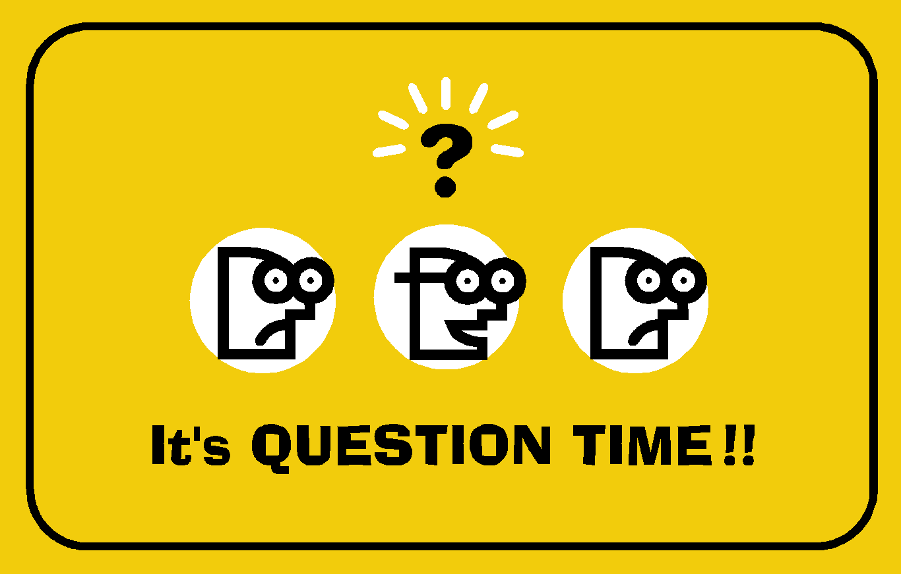
Thank you Merci ☺

